Slide 1
June 30, 2021 Work Group Update
FSWG slide 2
OGWG slide 3
RTOWG slides 4-5
TDWG slide 6
RHPWG slide 7
WESTAR/WRAP slide 8

Slide 2
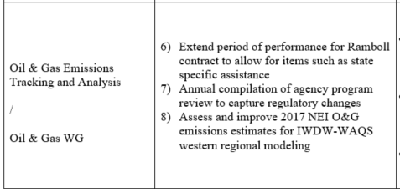
Oil & Gas Work Group Progress Update 12/1/2020 Board Approved Work Topics
June 2021
Mid- June – Co-chairs met with Darla Potter and Tom Moore to discuss our board approved Project/Tasks.
Co-chairs decided to regroup and reevaluate the work group scope and project/tasks approved by the board to ensure that we are being responsive to the needs of WRAP O&G states, and optimizing use of resources.
Early July and late July (to be scheduled): limited state-only meetings with inventory staff to discuss oil and gas inventories, and needs for regional EI and modeling platforms, considering possibly focusing on 2020 or other future years, rather than 2017; and consider current needs.
August 3rd -2:00 p.m. – 3:30 - p.m. (note new time) full OGWG call
Create transparency and report back on State specific O&G planning needs discussed for feedback
Discuss ideas for a path forward and project/task revision or reorganization.

Slide 3
Fire & Smoke Work Group Progress Update 12/1/2020 Board Approved Work Topics
June 2021
1), 2) → SMP Mapping Tool Team:
On hold for a month of two until RH SIP work done
3) → Exceptional Events Support Team:
Updating EE Data Resources List - drafted update, under review
First meeting July 8
4) → Conceptual Model for Fire Data:
Working on funding applications
Planning stakeholder workshops - delayed until October
5) → Wildland/Rx Fire Nexus Team: Set to simmer until RH SIPs are done.
5) → On June 28 call, ID presented on their efforts towards interagency coordination, communication, and stakeholder engagement.
Next call – Monday July 26

Slide 4
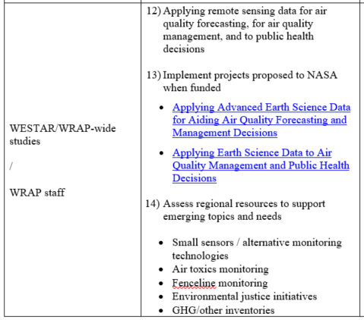
WESTAR/WRAP Progress Update 12/1/2020 Board Approved Work Topics
June 2021
#12-13 – to be combined under 2 new project funding proposals to NASA
NNH21ZDA001N-HAQ:A.37 Earth Science Applications: Health and Air Quality
Proposals submitted today
Funding up to $250-$300k/year for 3 years
Wildland Fire Emissions Data Warehouse (WFEDW)
To build / implement FSWG Conceptual Model for Fire Data
WESTAR-WRAP managed, work by Air Sciences (science data design), Michigan Tech Research Institute (emissions tools), and CSU-CIRA (warehouse)
Workshop in Oct. while NASA decides on funding
Organizing Remote Sensing Science Data for a Purpose: Decision Support Systems for Air Quality Management Applications
Address gaps between Earth Science data and routine evaluation and application by air quality management agencies for regulatory analysis and decision-making activities
Co-managed by University of Alabama in Huntsville and WESTAR-WRAP, leveraging inputs from experts at air agencies in the West and WESTAR-WRAP Work groups
#14 – no change, awaiting policy / implementation strategies from Biden EPA
#16 – plan is to have Tom and Jay Baker help states with questions in SIP submittal and EPA review process, no plans for other contracted support
WESTAR-WRAP will maintain operating agreement with CSU-CIRA for TSS / IWDW

